Slide 1

NBA All-Star by Smashmouth
By William Parlan and Aaron Miller

Slide 2

Why Did we Do This

Slide 3
Why Us?
Wanted an easy dataset to work with so went with basketball-reference
Every year there are debates about who should or shouldn’t be an all-star
Lots of potential all-star snubs or undeserving all-stars

Slide 4
Data Description
Name in CSV | Common Name
FG% | Field Goal Percentage
3P% | 3-point Field Goal Percentage
TRB | Total Rebounds
AST | Assists
STL | Steals
BLK | Blocks
PTS | Points

Slide 5
Data Description Continued
Name in CSV | Common Name | Meaning
eFG% | Effective Field Goal Percentage | Field Goal Percentage adjust for the fact that 3-Point Field Goals are worth one more point than 2-point goals.
TS% | True Shooting Percentage | A measure of shooting efficiency that takes into account 2-point field goals, 3-point field goals, and free throws.
PER | Player Efficiency Rating | A measure of per-minute production standardized such that the league average is 15
WS | Win Shares | An estimate of the number of wins contributed by a player
BPM | Box Plus Minus | A box score estimate of the points per 100 possesions a player contributed above a league-average player, translated to an average team
VORP | Value Over Replacement Player | A box score estimate of the points per 100 TEAM possesions that a player contributed above a replacement-level (-2.0) player, translated to an average team and prorated to an 82-game season. Multiply by 2.70 to convert to wins over replacement
All-star | Is this player an All-star? | This is our class label we are trying to predict

Slide 6

Exploratory Data Analysis

Slide 7
Methods
Compute Equal Width Cutoffs
1
Compute Bin Frequency
2
Separate All-star from non-all-star
3

Slide 8
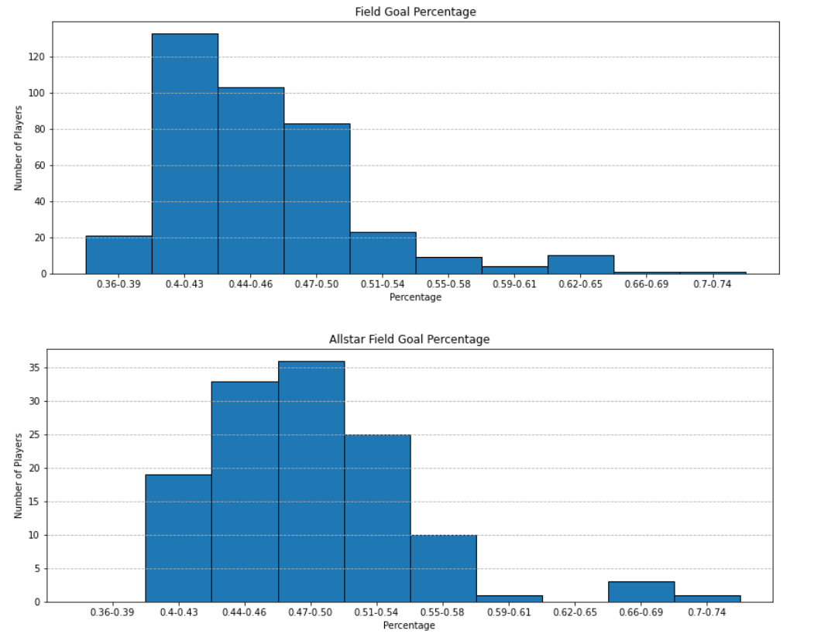
Trait 1: Field Goal Percentage
Allstar data is less heavily left skewed than other players.

Slide 9
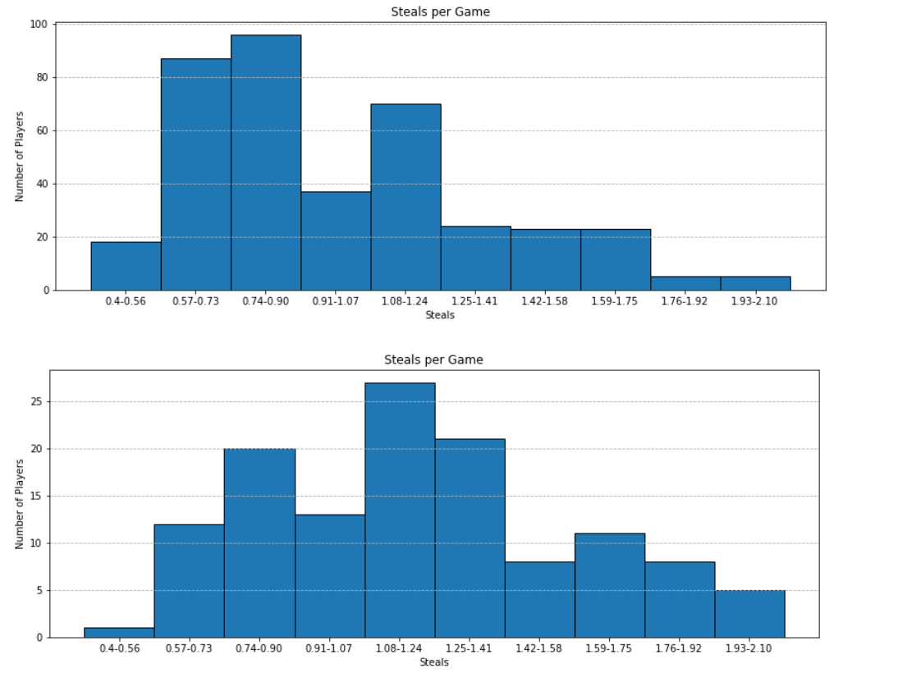
Trait 2: Steals per Game
Once again, allstar data is less heavily left skewed than other players.
Allstar data is pseudo-normal.

Slide 10
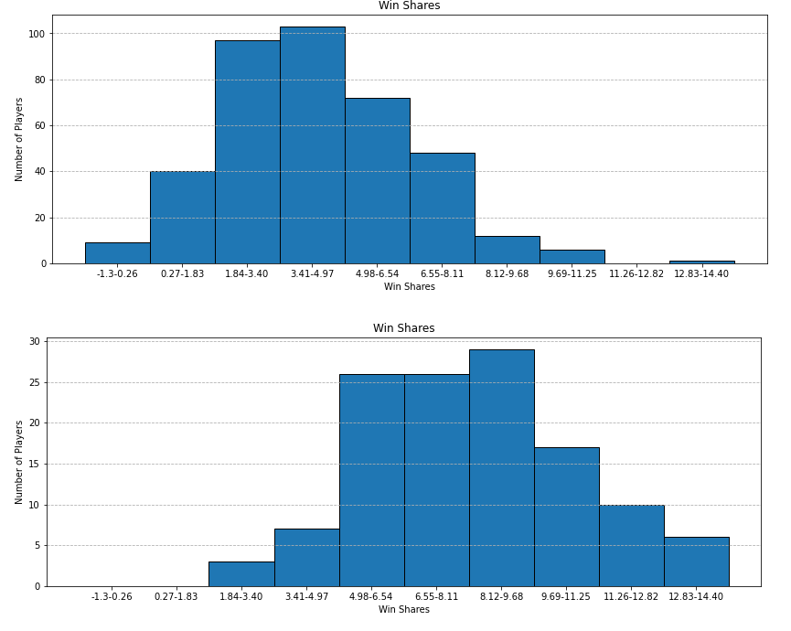
Trait 3: Win Shares
An estimate of the number of wins contributed by a player
Allstar is significantly right shifted

Slide 11

Classification Results

Slide 12
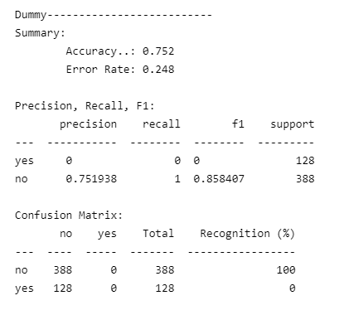
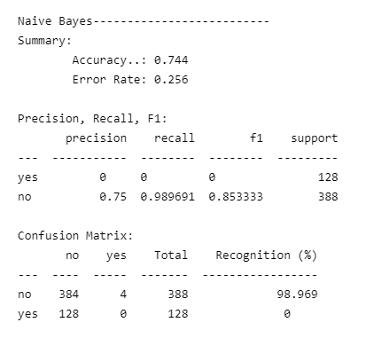
Using Only Effective Field Goal Percentage

Slide 13
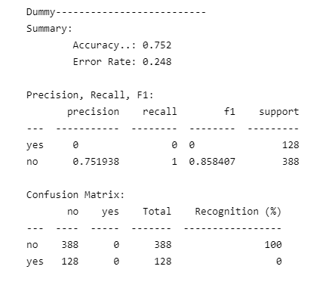
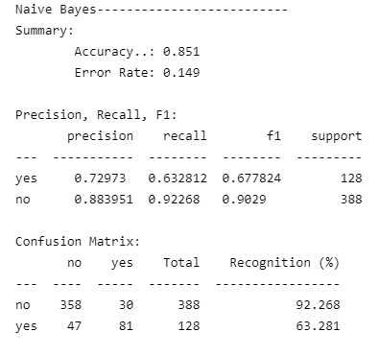
Using rebounds, assists, steals, blocks, and points per game

Slide 14
Flask App
A brief description and Flask demo/screenshot of the “best” classifier you ended up building for the dataset.

Slide 15

Conclusion

Slide 16

Improvements looking forward
More Data! Only 517 instances and 1/5 were All-star
Narrower discretization (more bins)
Informed attribute combinations

Slide 17
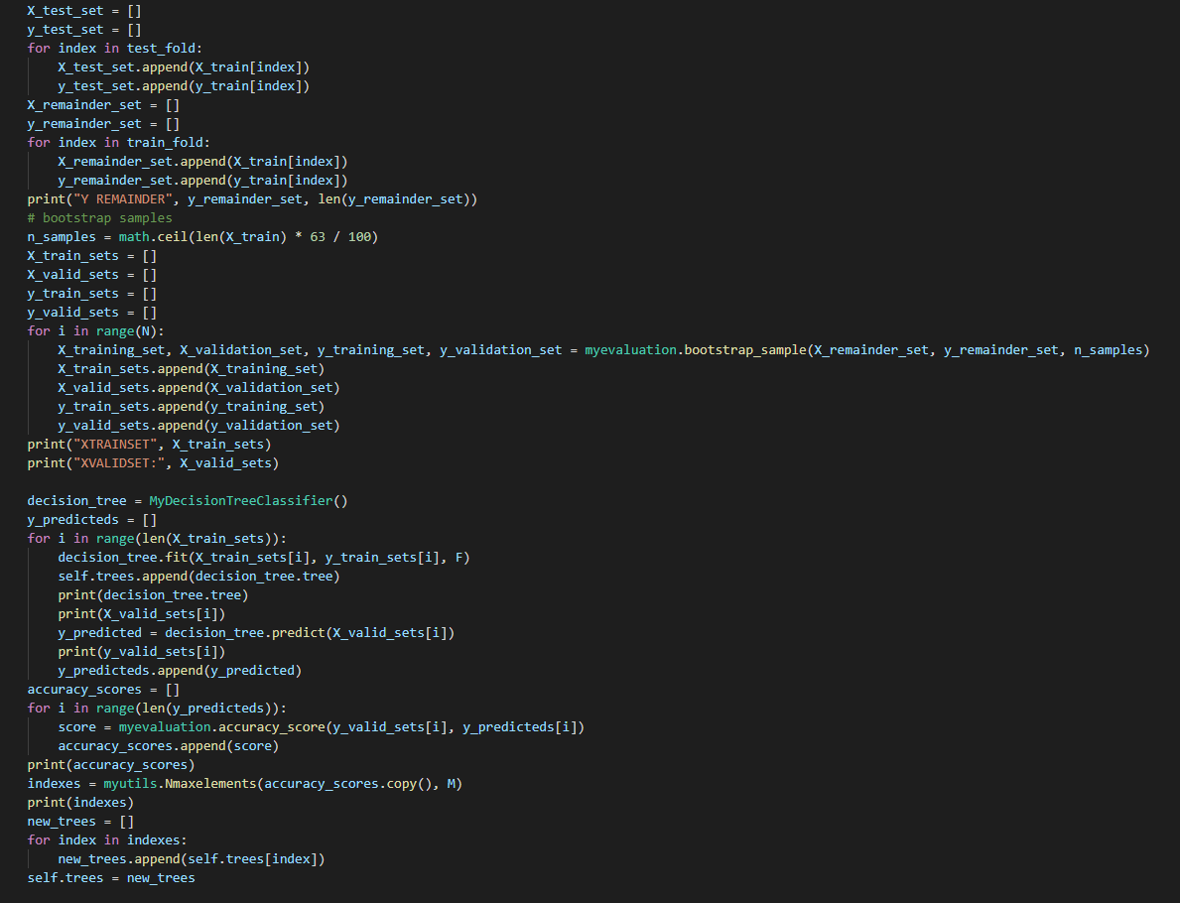
Code Highlights

Slide 18

Partner Breakdown
Aaron
Random Forest
Creative Head
William
EDA
Final Notebook
This presentation!

Slide 19

Sources
Per Game Stats: https://www.basketball-reference.com/leagues/NBA_2021_per_game.html
Advanced Stats:
https://www.basketball-reference.com/leagues/NBA_2021_advanced.html

Slide 20
NBA All-Star by Smashmouth
By William Parlan and Aaron Miller

